Slide 1
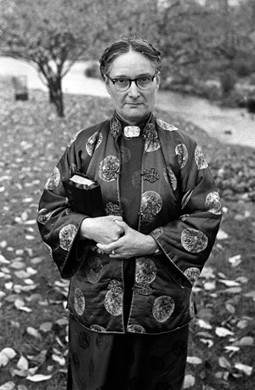
Gladys Aylward
02/1902 – 01/1970
AKA ‘Small Woman’

Slide 2
Gladys Aylward
Born in London, February of 1902
Raised in a poor family
Accepted Christ at age 27
She felt strongly that God wanted her to serve Him as a missionary
Attended China Inland Mission training school but was dismissed.
Self-supported missionary to go to China
Worked as a house maid to save money

Slide 3
Gladys Aylward
Oct 1932 Boarded the Trans-Siberian Rail-way
Forced to stop at Chita Russia.
Had to take a detour to Japan
Nov 1932, Arrived at TianJin
Through TianJin Missionary Center, got in touch with the local CIM office
Went to work with 73 years old Jeannie Lawson in ShanXi, Yangcheng
Notes:
中國 山西省 晉城市 陽城縣

Slide 4
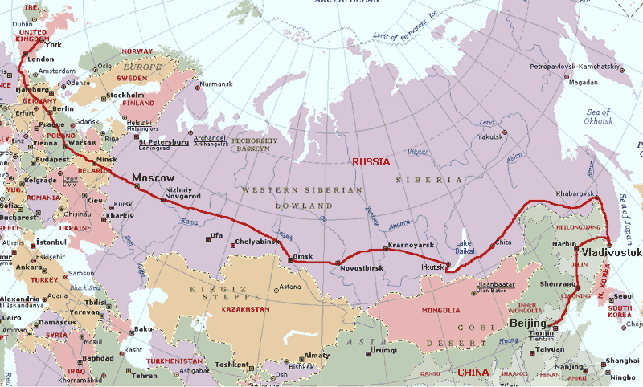
Notes:
A – Liverpool
B – Holland
C – Moscow
D – Chita
E – ShanXi

Slide 5
Gladys Aylward
Fulfilled Lawson’s vision - 八福客棧
Nov 1932, Jeannie died in an accident
Left to run the mission alone with the Chinese cook who is also a Christian
Appointed to be the ‘Foot Inspector’
Visit remote villages - an opportunity to spread God’s word
Brought to town prison to calm a prison riot
Faced a prisoner with an ax who already killed two fellow inmates

Slide 6
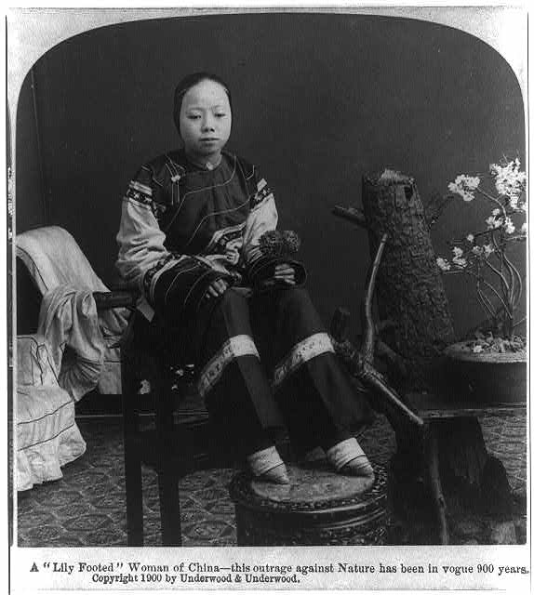

Slide 7
Gladys Aylward

Slide 8
Gladys Aylward
July 1937 – 2nd Sino-Japanese War broke out
Spring 1938 - inn has been bombed
Missionary work turned in different direction
Caring for the orphans
Tending the wounded soldiers
Helped the Resistant Army – wanted by the Japanese
Led 100 orphans (ages 3 to 16) to safety – travelled from YangCheng to SiAn

Slide 9
Gladys Aylward
Spring 1949 Returned to England to recover
1950 – China expelled foreign missionaries
Failed many attempts to re-enter China from Hong Kong and Taiwan
1957 – Settled in Taiwan
established orphanage in Taipai
1970 – Passed away and buried in Taiwan

Slide 10
MISS GLADYS AYLWARD, MISSIONARY (1902-1970) Born on the Twenty-Fourth of February Nineteen Hundred and Two in London, England. She came to China in Nineteen Hundred and Thirty to preach the Gospel in response to the Lord's call, And became a citizen of the Republic of China in Nineteen Hundred and Forty one. She was laid to rest in the Lord at Taipei, Taiwan, on the Second Day of January, Nineteen Hundred and Seventy.
* * * * "Unless a grain of wheat falls into the earth and dies, it remains alone; but if it dies it bears much fruit." - John 12:24

Slide 11
Gladys Aylward
References:
The Inn of Sixth Happiness Film – YouTube
http://www.youtube.com/watch?NR=1&v=kuwjjvMMqGM&feature=fvwp
Sermons
http://www.sermonindex.net/modules/mydownloads/viewcat.php?cid=63
八福客棧
http://www.ocbf.ca/2012/religion/missionary/story/4114
GLADYS AYLWARD – MISSIONARY TO CHINA (I) (1902 – 1970)
http://www.berithbpc.com/index.php/pastoral-exhortation/godly-men/220-gladys-aylward-missionary-to-china-i-1902-1970

Slide 12
Gladys Aylward
Robert Morrison 1807
Hudson Taylor 1853
Schofield 1883
Cambridge Seven 1885
Eric Liddell 1925
Gladys Aylward 1933

Slide 13
Gladys Aylward
1941 First woman missionary became naturalized Chinese citizen
Inn Keeper
Feet Inspector
Prison Ministry
Orphanage
Hospital

Slide 14
Gladys Aylward

