Slide 1
耶路撒冷日 / Yom Yerushalayim
5-29-2022 / יוֹם יְרוּשָׁלַיִם 5782
以珥月 Iyar 2/28/5782

Slide 3
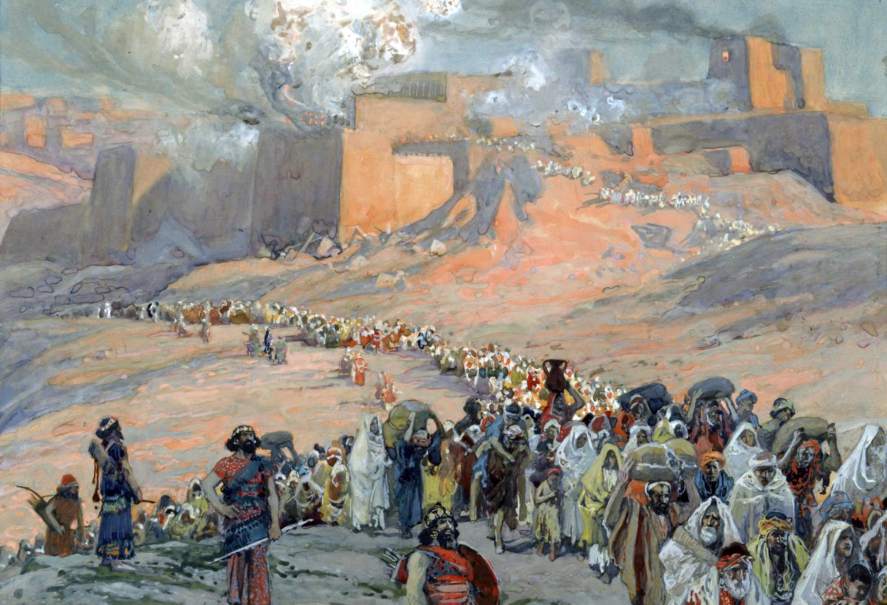

Slide 4
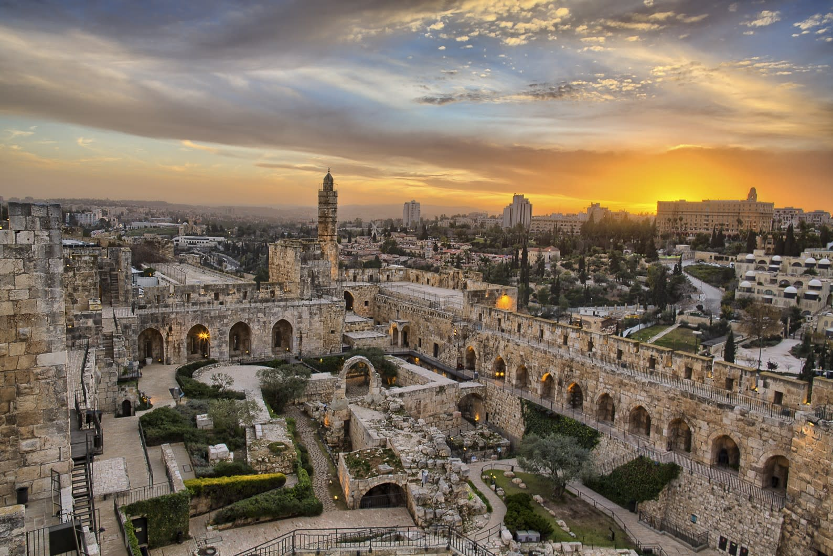

Slide 5
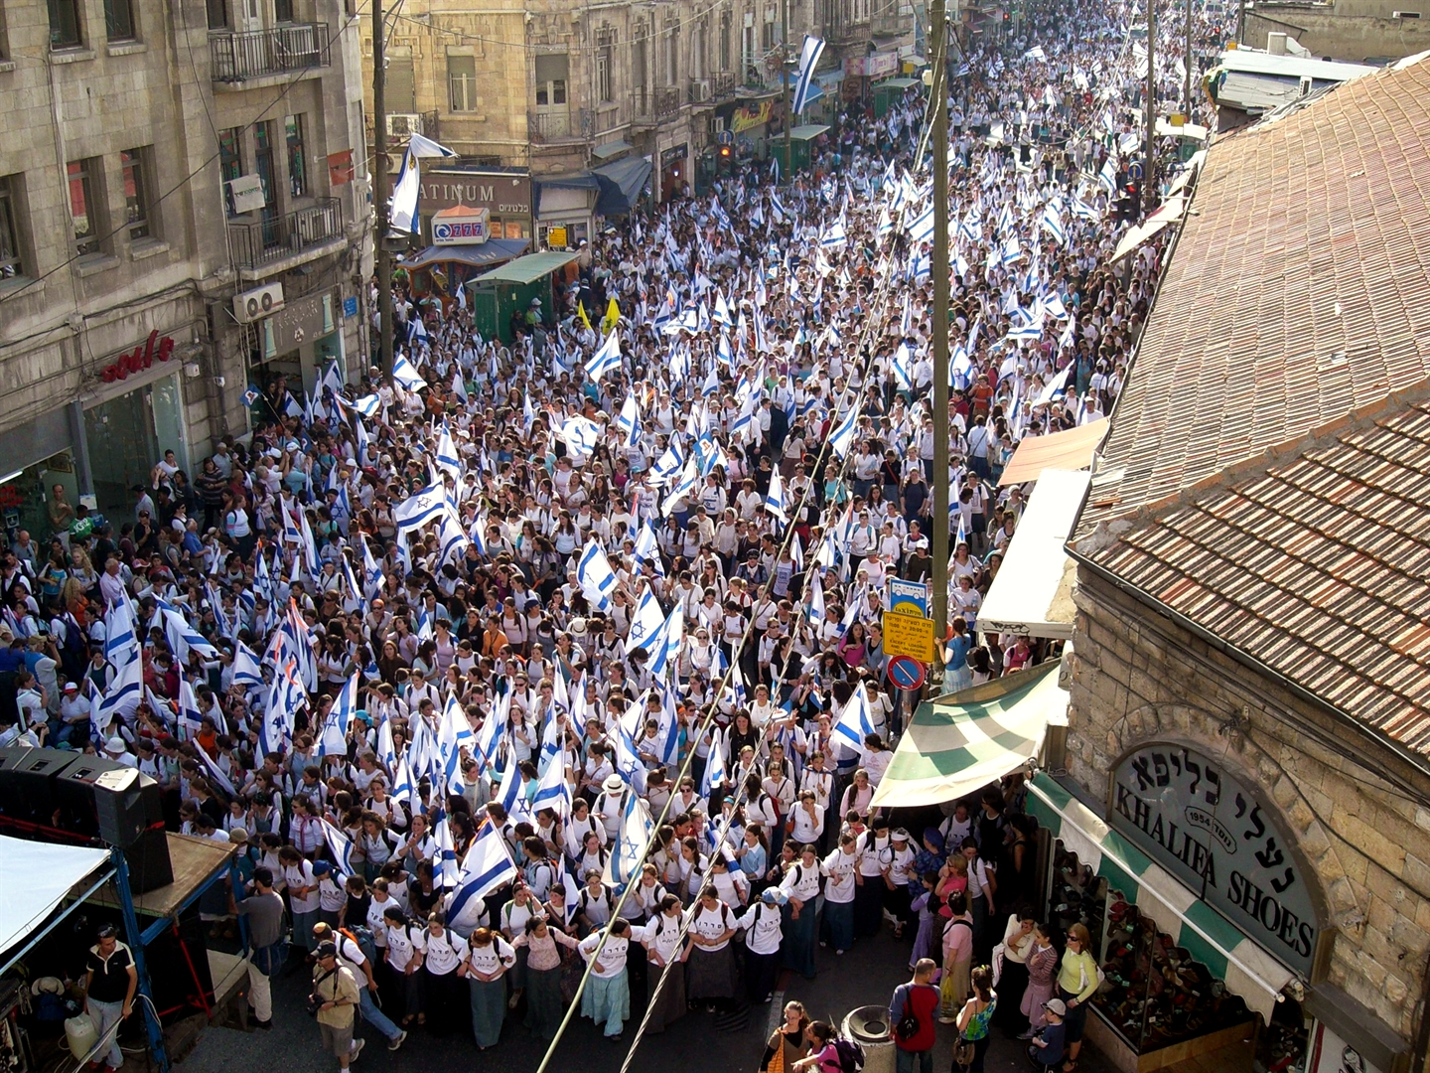

Slide 6
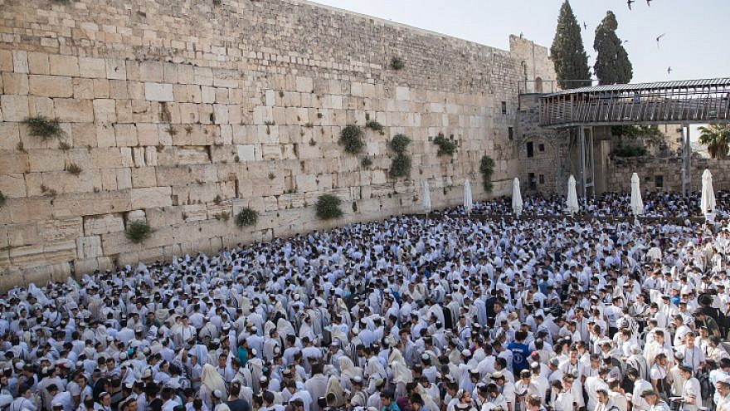

Slide 7
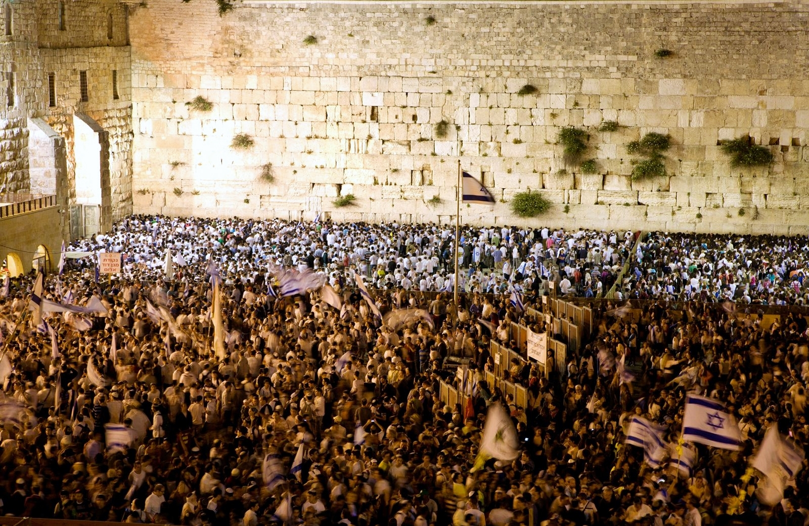

Slide 8
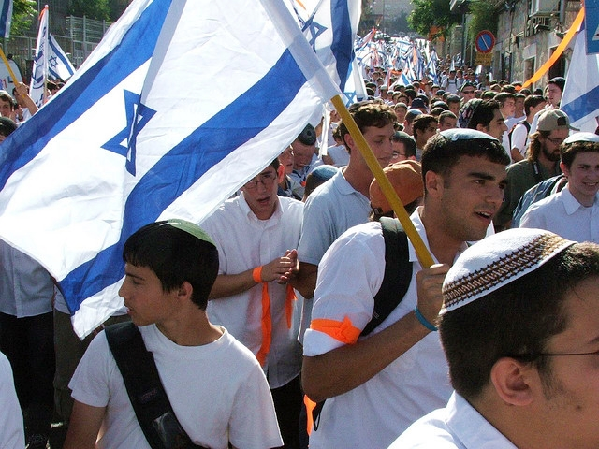
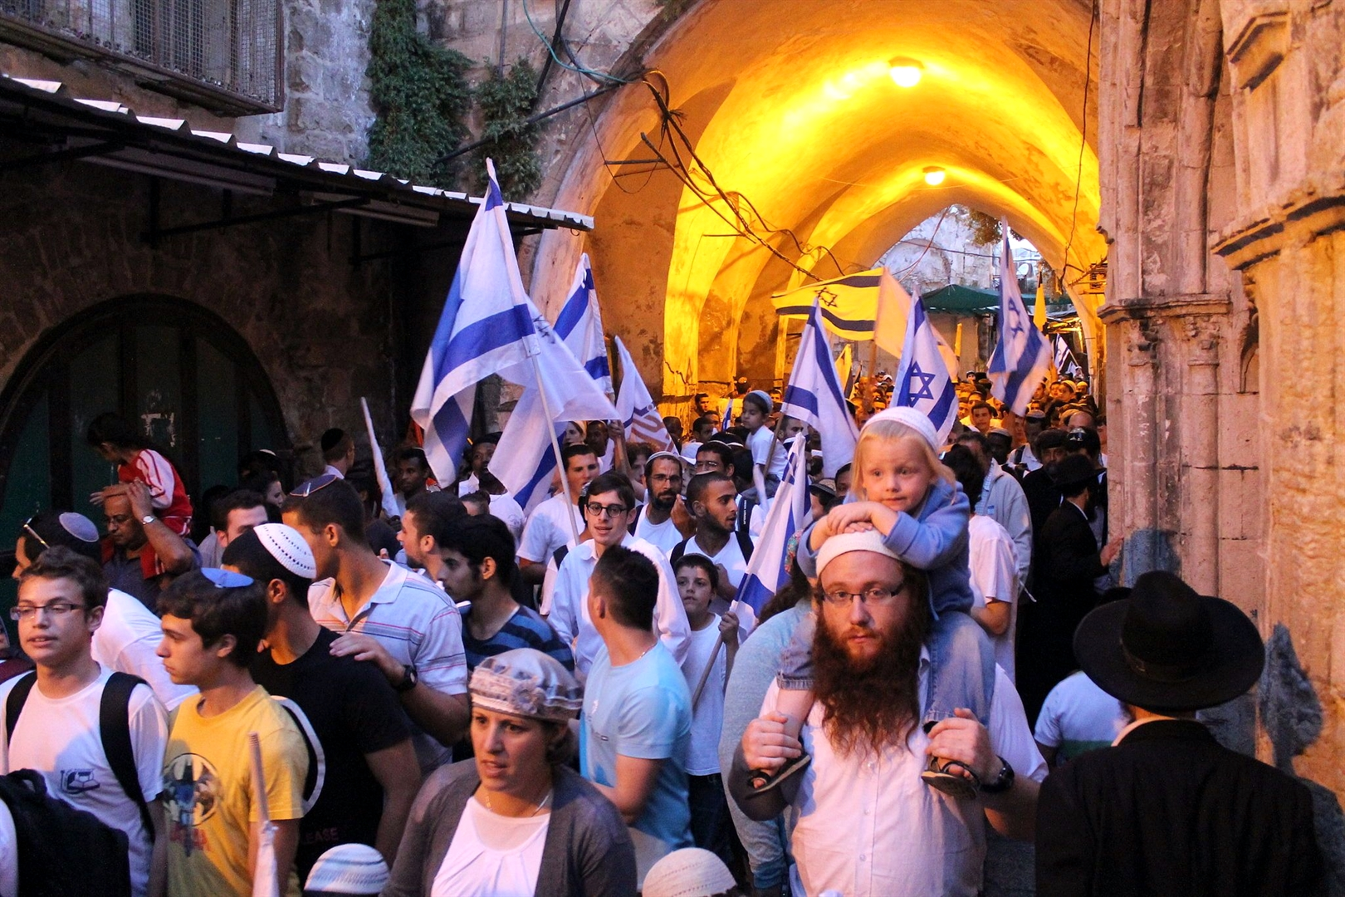
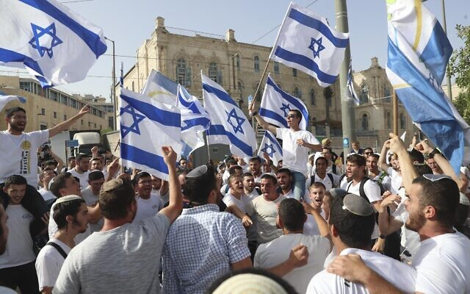
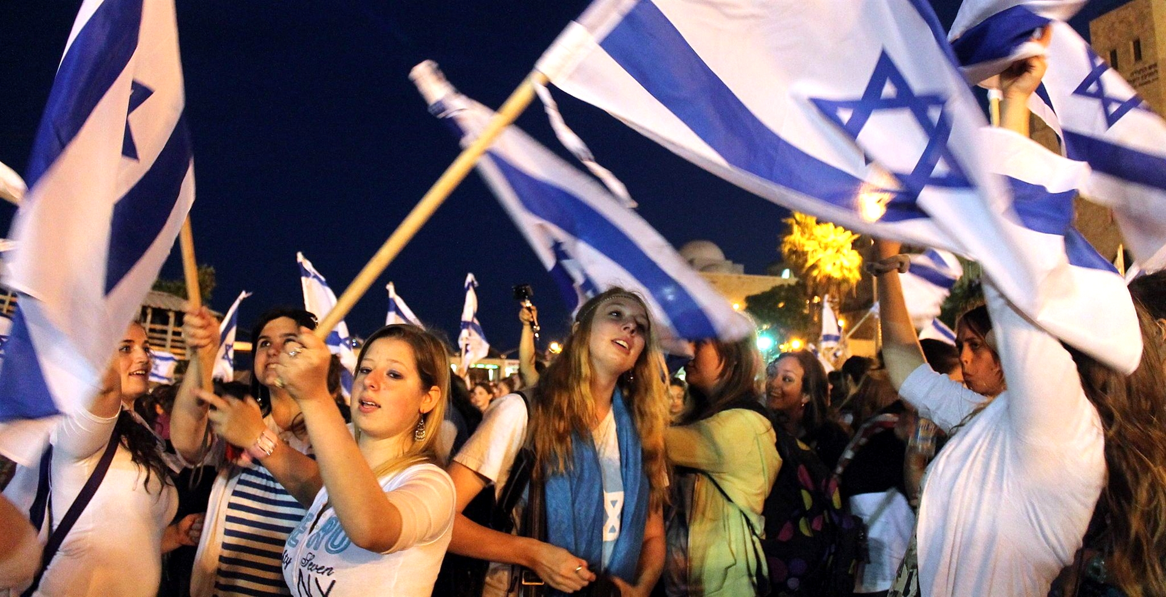

Slide 9
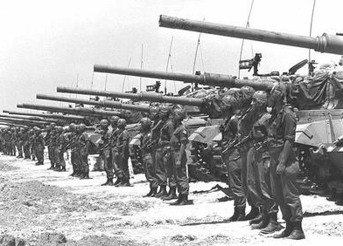
六日戰爭
6 / 5 –10 /1967

Slide 10
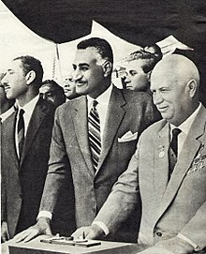
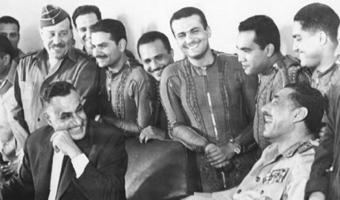
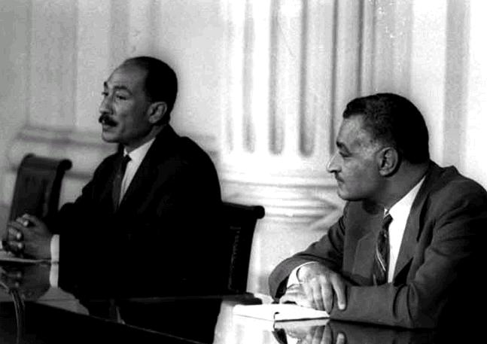
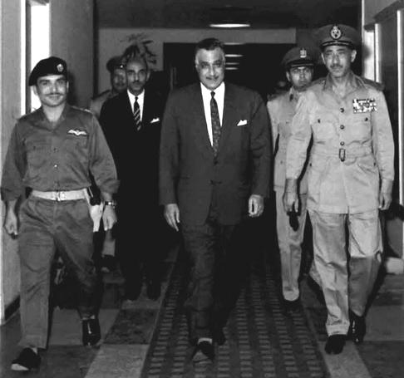
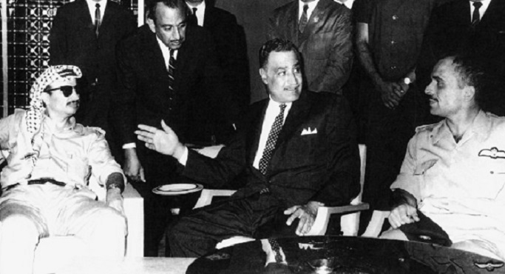

Slide 11
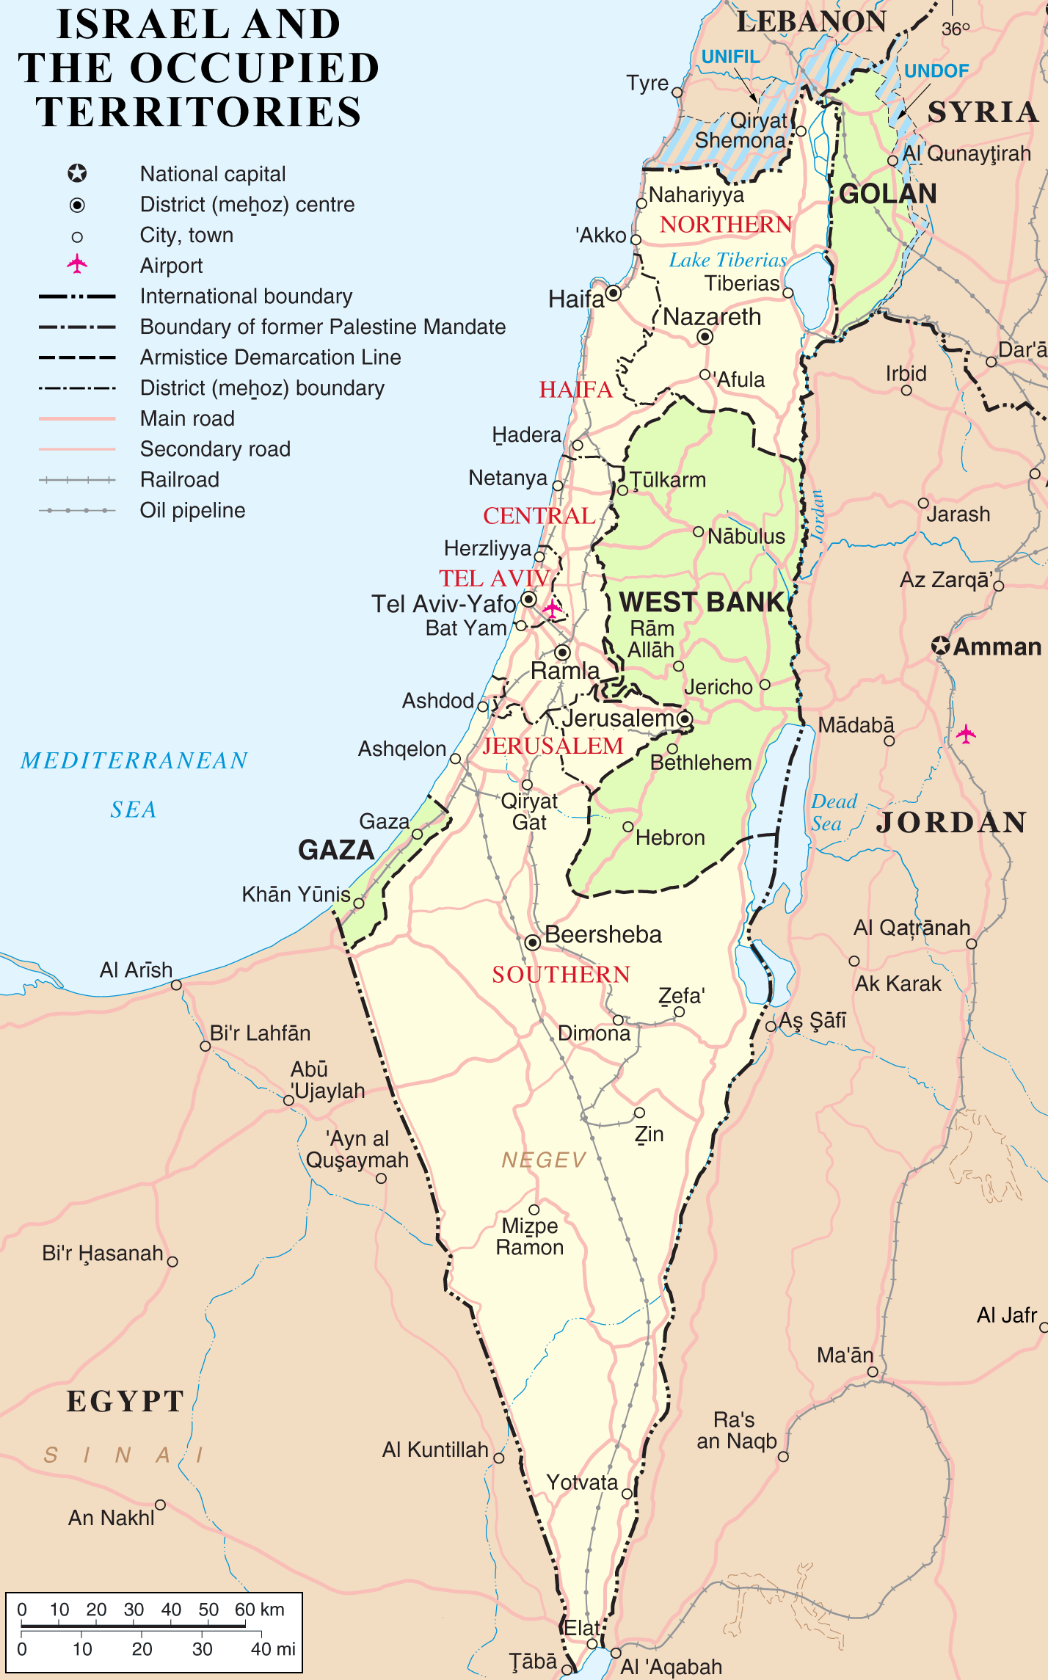

Slide 12
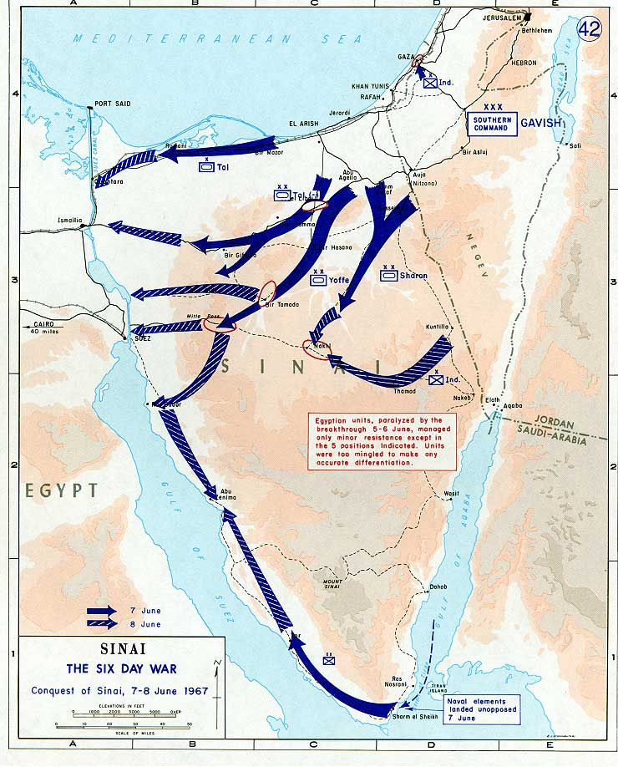

Slide 13
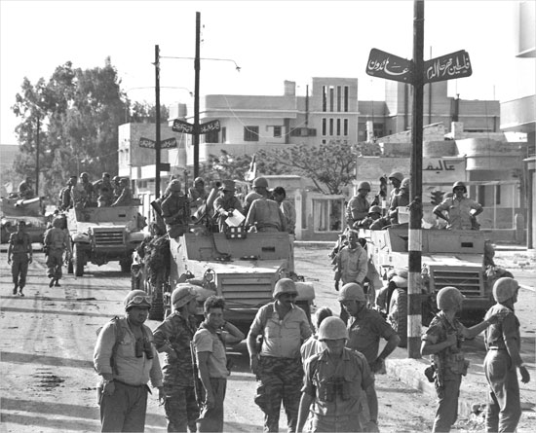
Gaza

Slide 14
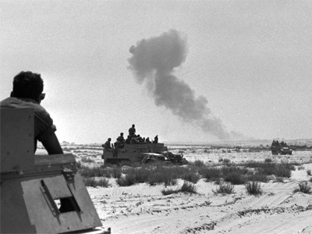
Rafah, Egypt

Slide 15
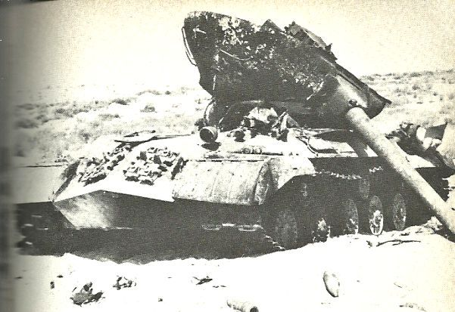

Slide 16
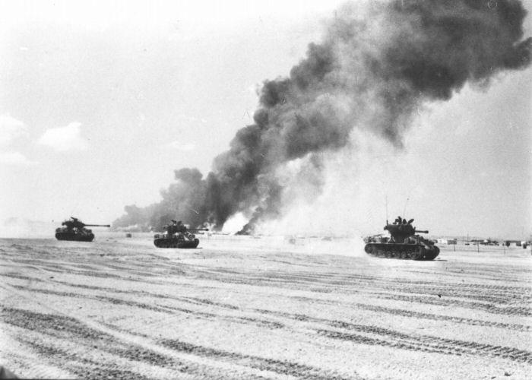
Sinai, Egypt

Slide 17
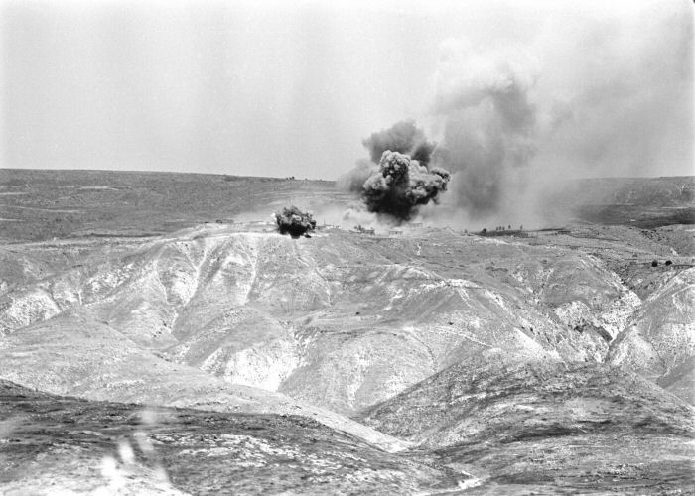
Sinai, Egypt

Slide 18
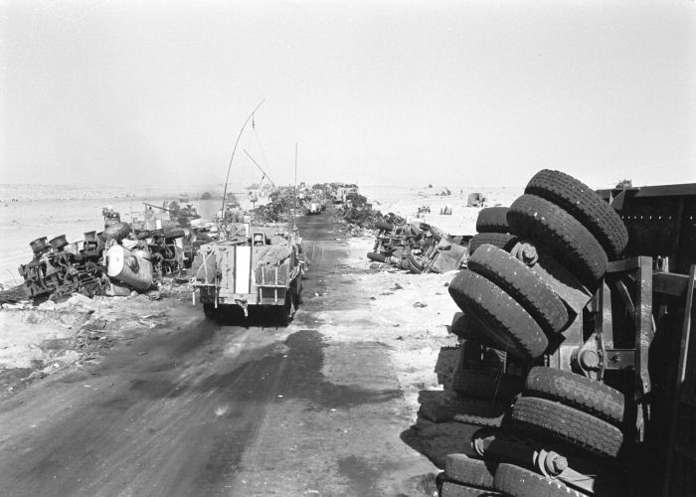
Egypt

Slide 19
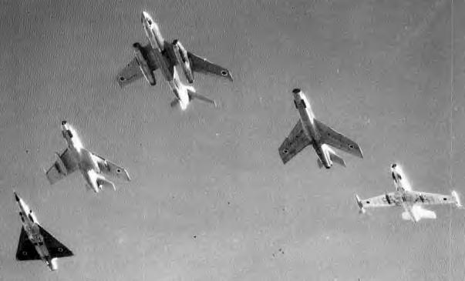
Israeli Defense Force

Slide 20
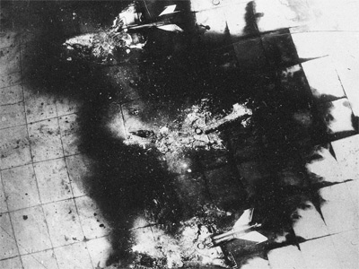
Egypt

Slide 21
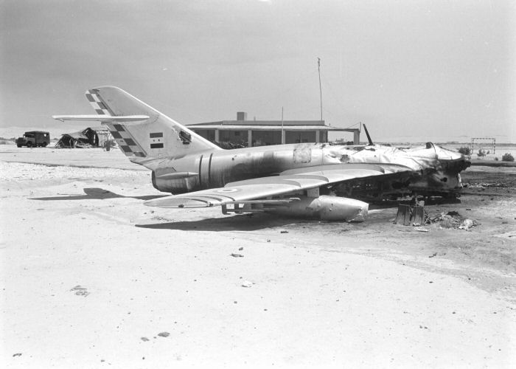
Egypt

Slide 22
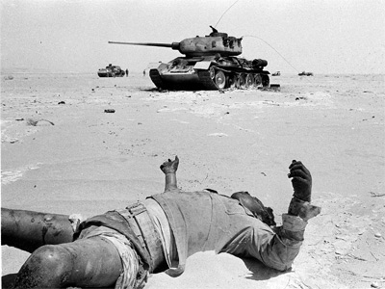
Egypt

Slide 23
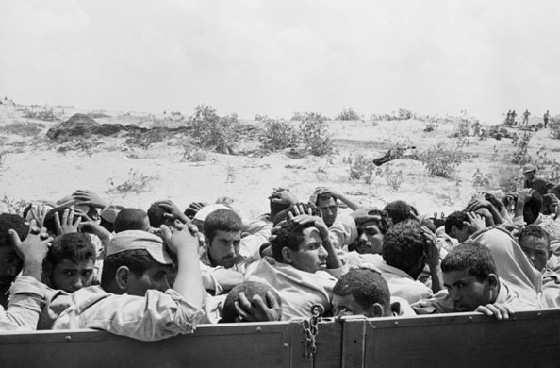
Egypt

Slide 24
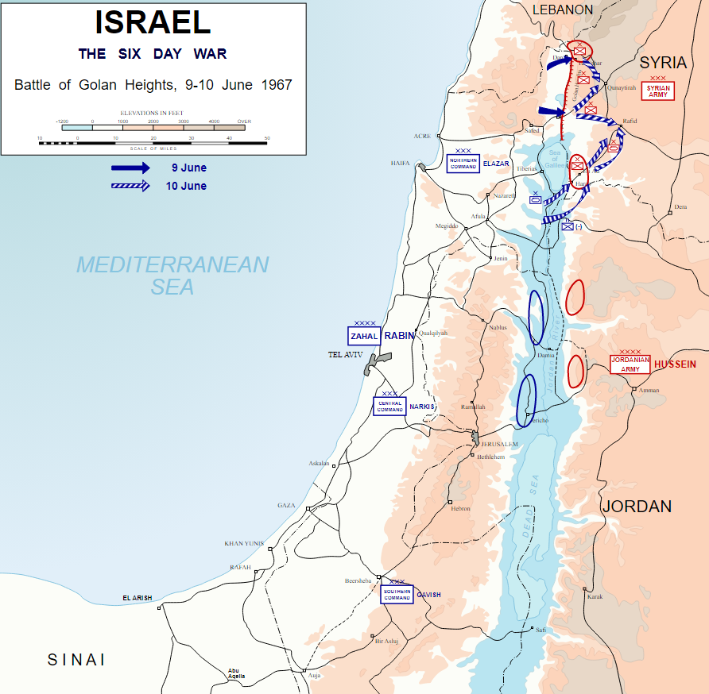

Slide 25
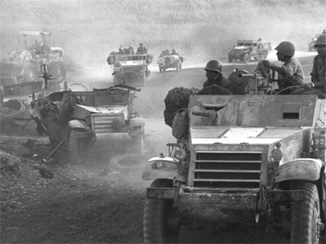
Syrian front in the Golan Heights

Slide 26
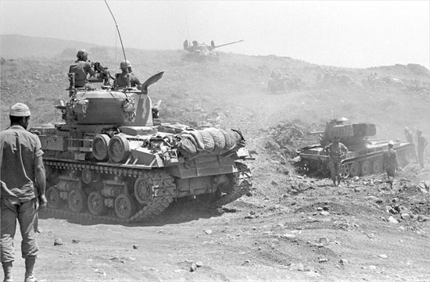
Syrian front in the Golan Heights

Slide 27
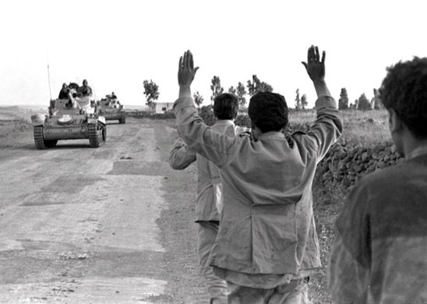
Syrian front in the Golan Heights

Slide 28
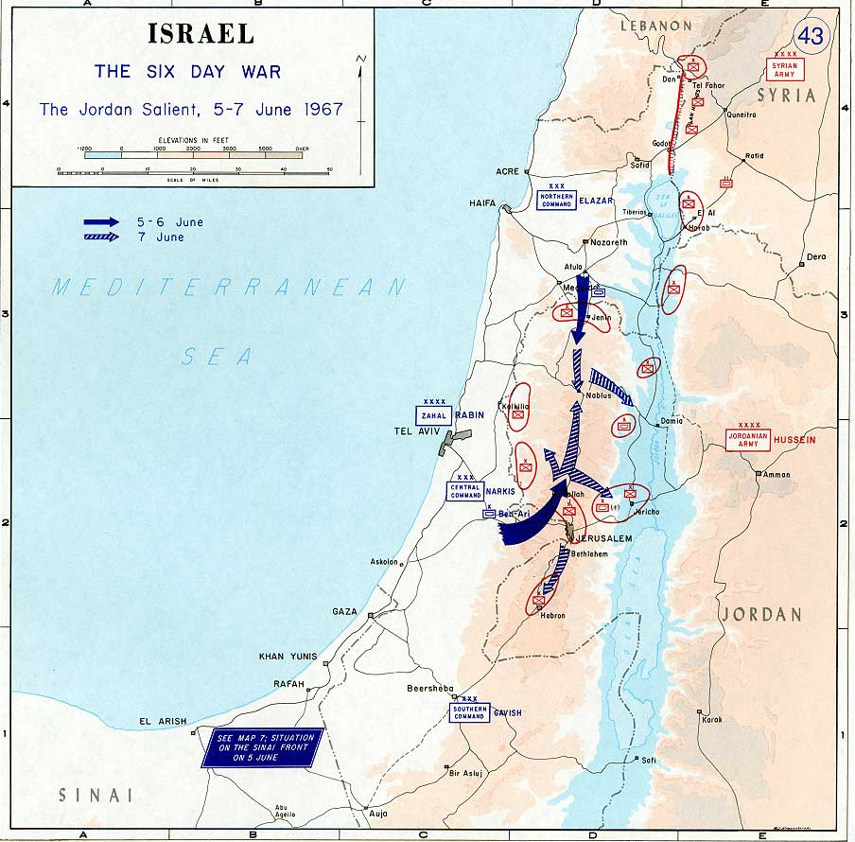

Slide 29
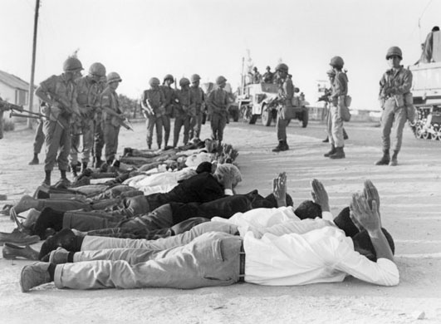
West Bank

Slide 30
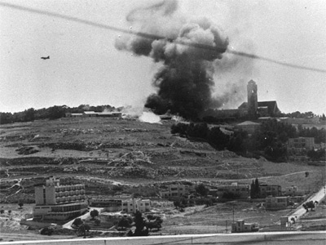
Jerusalem

Slide 31
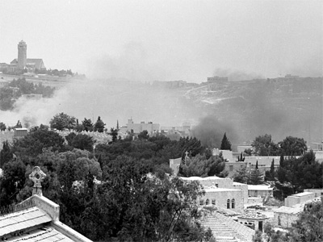
Jerusalem

Slide 32
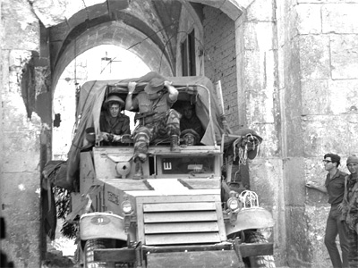
Lion's Gate
Jerusalem

Slide 33
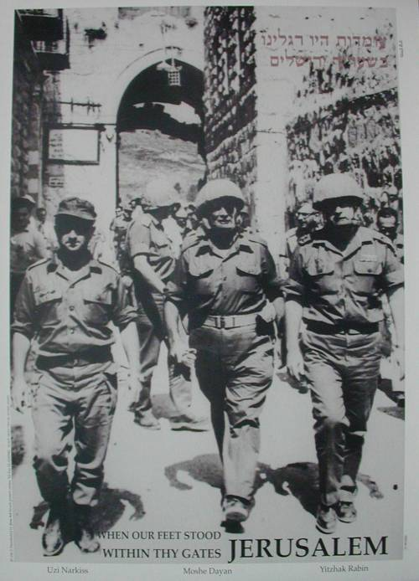
Lion's Gate
Jerusalem

Slide 34
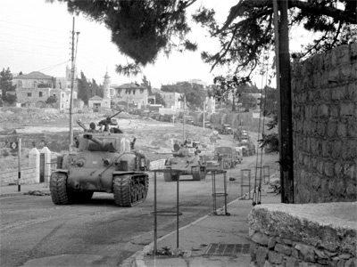
Jerusalem

Slide 35
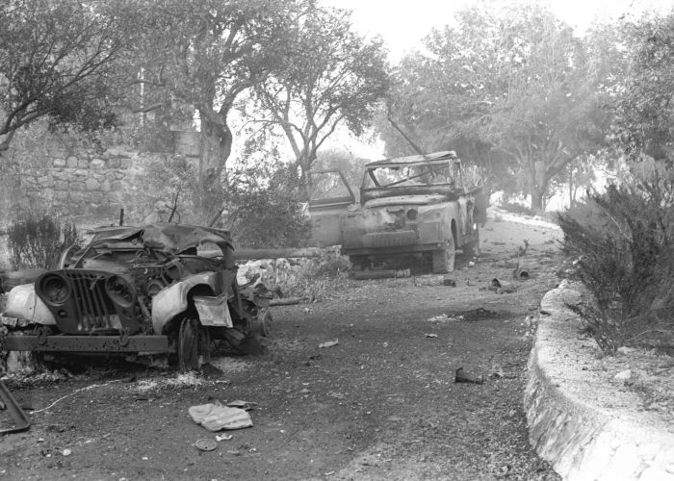
Jerusalem

Slide 36
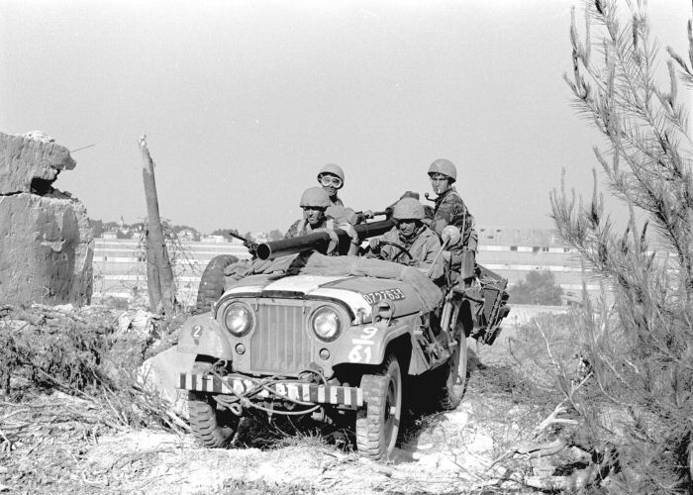
Jerusalem

Slide 37
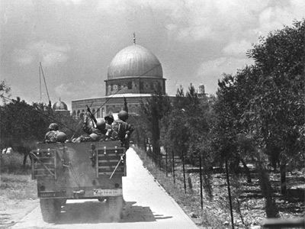
Jerusalem

Slide 38
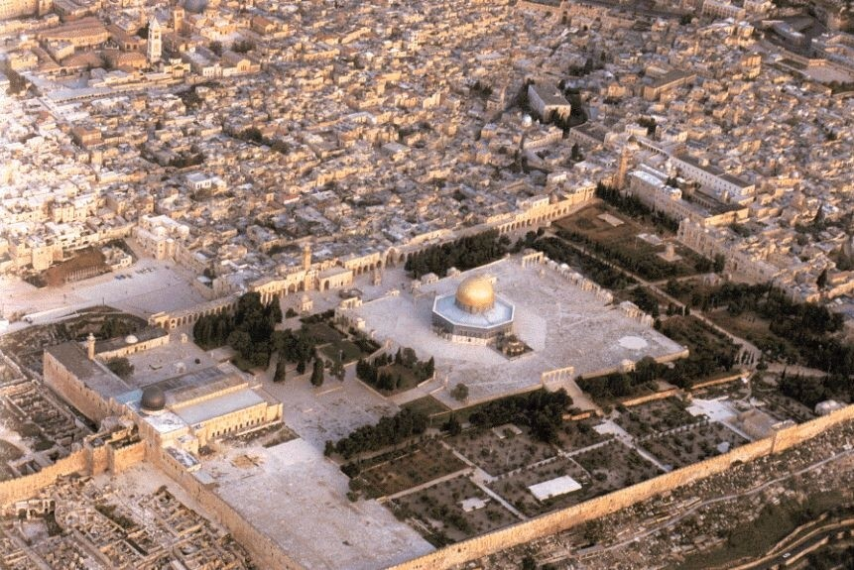

Slide 39
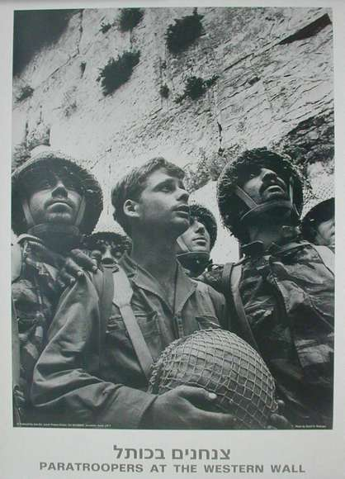
Wailing Wall

Slide 40
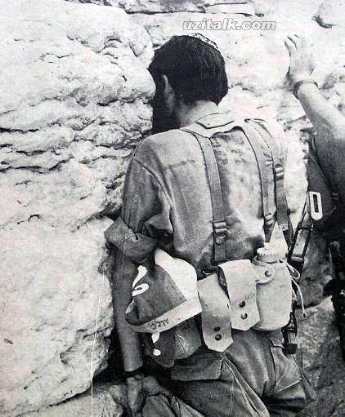
Wailing Wall

Slide 41
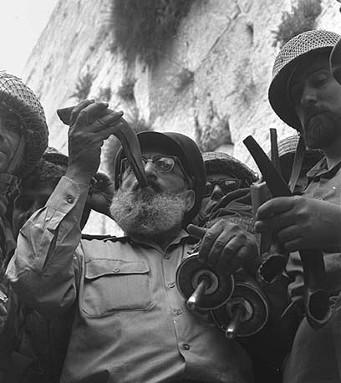
Wailing Wall

Slide 42
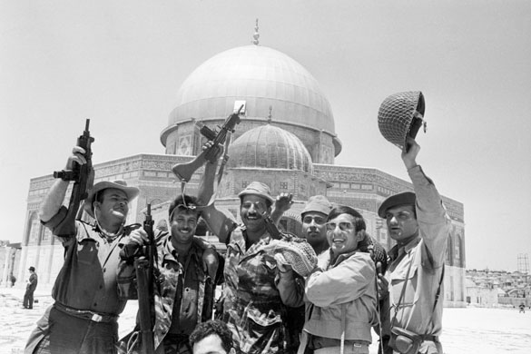
Jerusalem
6/11/1967

Slide 43
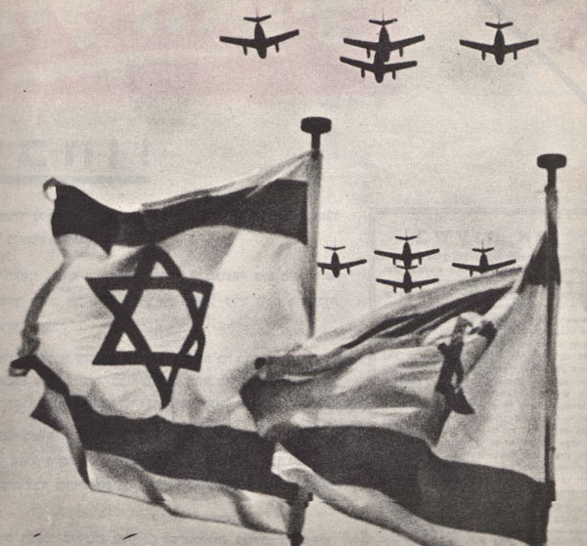

Slide 44
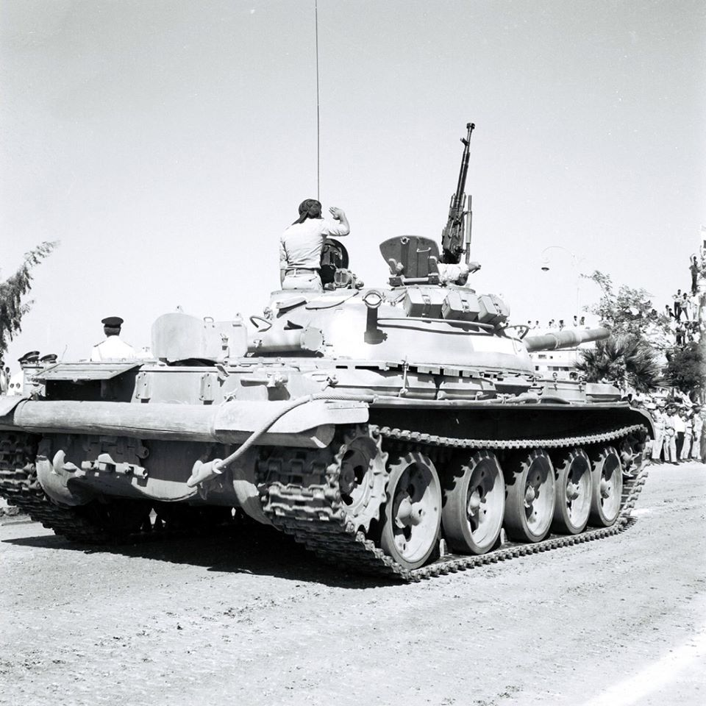
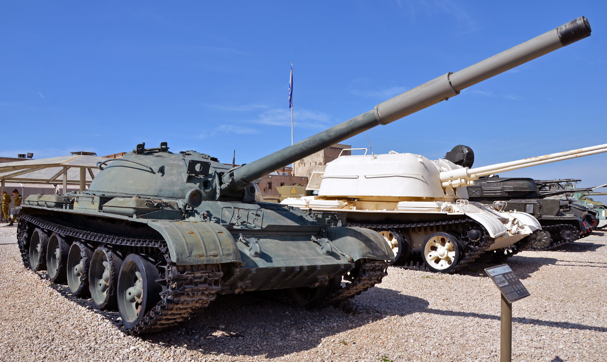
Russian T-62 Egypt 1967

Slide 45
Ukraine 2022
Egypt 1967

Slide 46
Ukraine 2022

Slide 49
詩篇 120-134 上行之詩song of ascents

Slide 50
詩篇 121 上行之詩。
我要向山舉目。我的幫助從何而來？
我的幫助從造天地的耶和華而來。
他必不叫你的腳搖動,
保護你的必不打盹。
保護以色列的也不打盹, 也不睡覺。
保護你的是耶和華,
耶和華在你右邊蔭庇你。
白日，太陽必不傷你；
夜間，月亮必不害你。
耶和華要保護你免受一切的災害，
他要保護你的性命。
你出你入, 耶和華要保護你,
從今時直到永遠。
A song of ascents:
If I raise my eyes to the hills,
From where will my help come?
My help comes from ADONAI,
The maker of heaven and earth.
He will not let your foot slip -
your guardian is not asleep.
No, the guardian of Isra’el
never slumbers or sleeps.
ADONAI is your guardian; at your right hand
ADONAI provides you with shade –
The sun can’t strike you during the day
Or even the moon at night.
ADONAI will guard you against all harm;
He will guard your life.
ADONAI will guard your coming and going
from now on and forever.

Slide 51
詩篇 122 大衛上行之詩。
人對我說: 「我們往耶和華的殿去」, 我就歡喜。
耶路撒冷啊! 我們的腳站在你的門內。 耶路撒冷被建造，如同連絡整齊的一座城。 眾支派，就是耶和華的支派，上那裡去，
按以色列的常例稱讚耶和華的名。 因為在那裡設立審判的寶座，
就是大衛家的寶座。
你們要為耶路撒冷求平安：
耶路撒冷啊! 愛你的人必然興旺。
願你城中平安, 願你宮內興旺! 因我弟兄和同伴的緣故，我要說：
願平安在你中間！ 因耶和華我們神殿的緣故，我要為你求福。
A song of ascents. By David:
I was glad when they said to me,
“The house of ADONAI! Let’s go!”
Our feet were already standing
at your gates, Yerushalayim.
Yerushalayim, built as a city
fostering friendship and unity.
The tribes have gone up there, the tribes of ADONAI,
as a witness to Isra’el,
To give thanks to the name of ADONAI.
For there the thrones of justice were set up,
The thrones of the house of David.
Pray for shalom in Yerushalayim;
may those who love you prosper.
May shalom be within your ramparts,
Prosperity in your palaces.
For the sake of my family and friends, I say,
“Shalom be within you!”
For the sake of the house of ADONAI our G-D,
I will seek your well-being.

Slide 52
詩篇 126 上行之詩。
當耶和華將那些被擄的
帶回錫安的時候，
我們好像做夢的人。
我們滿口喜笑、滿舌歡呼的時候，
外邦中就有人說：
耶和華為他們行了大事！
耶和華果然為我們行了大事，
我們就歡喜。
耶和華啊!
求你使我們被擄的人歸回，
好像南地的河水復流。
流淚撒種的，必歡呼收割。 那帶種流淚出去的，
必要歡歡樂樂地帶禾捆回來。
A song of ascents.
When ADONAI restored Tziyon’s fortunes,
We thought we were dreaming.
Our mouths were full of laughter,
And our tongues shouted for joy.
Among the nations it was said,
ADONAI has done great things for them!
ADONAI did do great things with us;
And we are overjoyed.
Return our people from exile, ADONAI,
As streams fill vadis in the Negev.
Those who sow in tears
will reap with cries of joy.
He who goes out weeping
as he carries his sack of seed
will come home with cries of joy
as he carries his sheaves of grain.

Slide 54
好像南地的河水復流。
As streams fill vadis in the Negev.

Slide 55
好像南地的河水復流。
As streams fill vadis in the Negev.

Slide 56
詩篇 126 上行之詩。
當耶和華將那些被擄的
帶回錫安的時候，
我們好像做夢的人。
我們滿口喜笑、滿舌歡呼的時候，
外邦中就有人說：
耶和華為他們行了大事！
耶和華果然為我們行了大事，
我們就歡喜。
耶和華啊!
求你使我們被擄的人歸回，
好像南地的河水復流。
流淚撒種的，必歡呼收割。 那帶種流淚出去的，
必要歡歡樂樂地帶禾捆回來。
A song of ascents.
When ADONAI restored Tziyon’s fortunes,
We thought we were dreaming.
Our mouths were full of laughter,
And our tongues shouted for joy.
Among the nations it was said,
ADONAI has done great things for them!
ADONAI did do great things with us;
And we are overjoyed.
Return our people from exile, ADONAI,
As streams fill vadis in the Negev.
Those who sow in tears
will reap with cries of joy.
He who goes out weeping
as he carries his sack of seed
will come home with cries of joy
as he carries his sheaves of grain.

Slide 57
詩篇 137
我們曾在巴比倫的河邊坐下，
一追想錫安就哭了。
我們把琴掛在那裡的柳樹上。
因為在那裡，擄掠我們的要我們唱歌，
搶奪我們的要我們作樂，
說：「給我們唱一首錫安歌吧! 」
我們怎能在外邦唱耶和華的歌呢？
耶路撒冷啊! 我若忘記你，
情願我的右手忘記技巧!
我若不記念你，
若不看耶路撒冷過於我所最喜樂的，
情願我的舌頭貼於上膛!
耶路撒冷遭難的日子，
以東人說：「拆毀! 拆毀! 直拆到根基!」
耶和華啊! 求你記念這仇!
將要被滅的巴比倫城啊!
報復你像你待我們的，那人便為有福！
拿你的嬰孩摔在磐石上的，那人便為有福！
By the river of Bavel we sat down and wept as we remembered Tziyon.
We had hung up our lyres on the willows that were there,
When those who had taken us captive asked us to sing them a song;
Our tormentors demanded joy from us –
“Sing us one of the songs from Tziyon!”
How can we sing a song about ADONAI here on foreign soil?
If I forget you, Yerushalayim,
may my right hand wither away!
May my tongue stick to the roof of my mouth!
If I fail to remember you,
if I fail to count Yerushalayim the greatest of all my joys.
Remember, ADONAI,
against the people of Edom the day of Yerushalayim’s fall,
how they cried, “Tear it down! Tear it down! Raze it to the ground!”
Daughter of Bavel, you will be destroyed!
A blessing on anyone who pays you back for the way you treated us!
A blessing on anyone who seizes your babies
and smashes them against a rock!

Slide 58
詩篇 126 上行之詩。
當耶和華將那些被擄的
帶回錫安的時候，
我們好像做夢的人。
我們滿口喜笑、滿舌歡呼的時候，
外邦中就有人說：
耶和華為他們行了大事！
耶和華果然為我們行了大事，
我們就歡喜。
耶和華啊!
求你使我們被擄的人歸回，
好像南地的河水復流。
流淚撒種的，必歡呼收割。 那帶種流淚出去的，
必要歡歡樂樂地帶禾捆回來。
Wailing Wall

Slide 59
耶路撒冷日 / Yom Yerushalayim
5-29-2022 / יוֹם יְרוּשָׁלַיִם 5782
以珥月 Iyar 2/28/5782

Slide 60
詩篇 144 大衛的詩。
¹ 耶和華我的磐石是應當稱頌的! 他教導我的手爭戰, 教導我的指頭打仗。 ² 他是我慈愛的主, 我的山寨, 我的高臺, 我的救主, 我的盾牌, 是我所投靠的,
他使我的百姓服在我以下。
³ 耶和華啊! 人算什麼，你竟認識他? 世人算什麼，你竟顧念他?
⁴ 人好像一口氣, 他的年日如同影兒快快過去。
⁵ 耶和華啊! 求你使天下垂, 親自降臨; 摸山, 山就冒煙。
⁶ 求你發出閃電, 使他們四散, 射出你的箭, 使他們擾亂。
⁷ 求你從上伸手救拔我, 救我出離大水, 救我脫離外邦人的手。
⁸ 他們的口說謊話, 他們的右手起假誓。
⁹ 神啊! 我要向你唱新歌, 用十弦瑟向你歌頌。
¹⁰ 你是那拯救君王的, 你是那救僕人大衛脫離害命之刀的。
¹¹ 求你救拔我, 救我脫離外邦人的手。 他們的口說謊話, 他們的右手起假誓。
¹² 我們的兒子從幼年好像樹栽子長大, 我們的女兒如同殿角石, 是按建宮的樣式鑿成的。
¹³ 我們的倉盈滿, 能出各樣的糧食, 我們的羊在田間孳生千萬。 ¹⁴ 我們的牛馱著滿馱, 沒有人闖進來搶奪,
也沒有人出去爭戰, 我們的街市上也沒有哭號的聲音。
¹⁵ 遇見這光景的百姓便為有福! 有耶和華為他們的神，這百姓便為有福!

